Slide 1


BOSH 1-Day Workshop
Matt Gunter
Sr Platform Architect
Mike Wright
Southeast PA Manager

Slide 2
Agenda
Introductions, Goals, Tour of lab env.
Introducing BOSH concepts
Anatomy of a BOSH deployment
Anatomy of a BOSH release
Pivotal Tiles, OpsManager, & Service Types

Slide 3
Goals
Understand the basic concepts of BOSH
Gain hands on experience working directly with BOSH from a user perspective
Build, Deploy, Test:
Release
Deployment
CF Service Broker

Slide 4
What is in the Environment for the Labs
Download bosh-lite
Download PcfDev
Install “Tree”
Git clone
https://github.com/mgunter-pivotal/cf-bosh-workshop.git
https://github.com/cloudfoundry-samples/spring-music.git

Slide 5
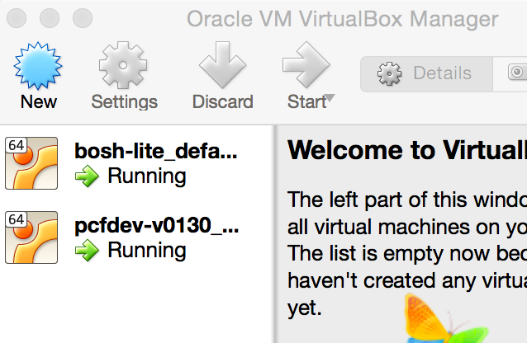

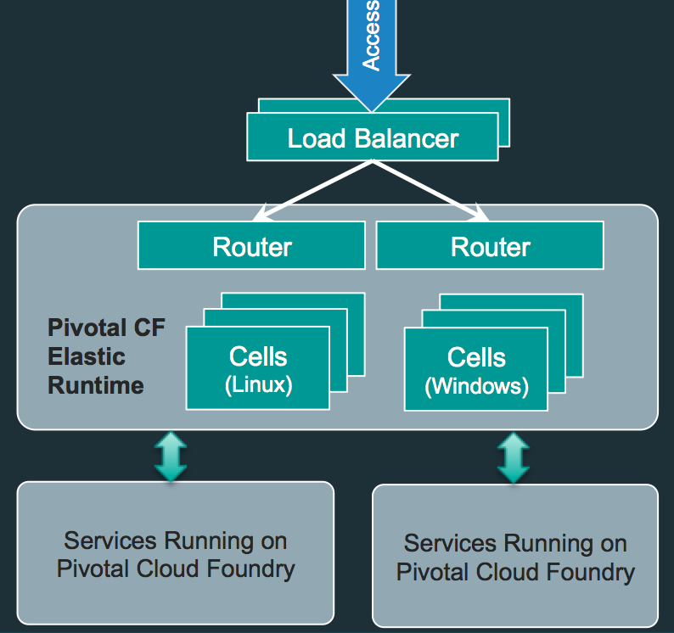
Laptop Environment for Lab
Vagrant
VBox
Bosh-Lite 192.168.50.4
PcfDev: 192.168.11.11
Postgres
10.68.45.151
Warden container
Bosh Director
VM
VM
Laptop:

Slide 6
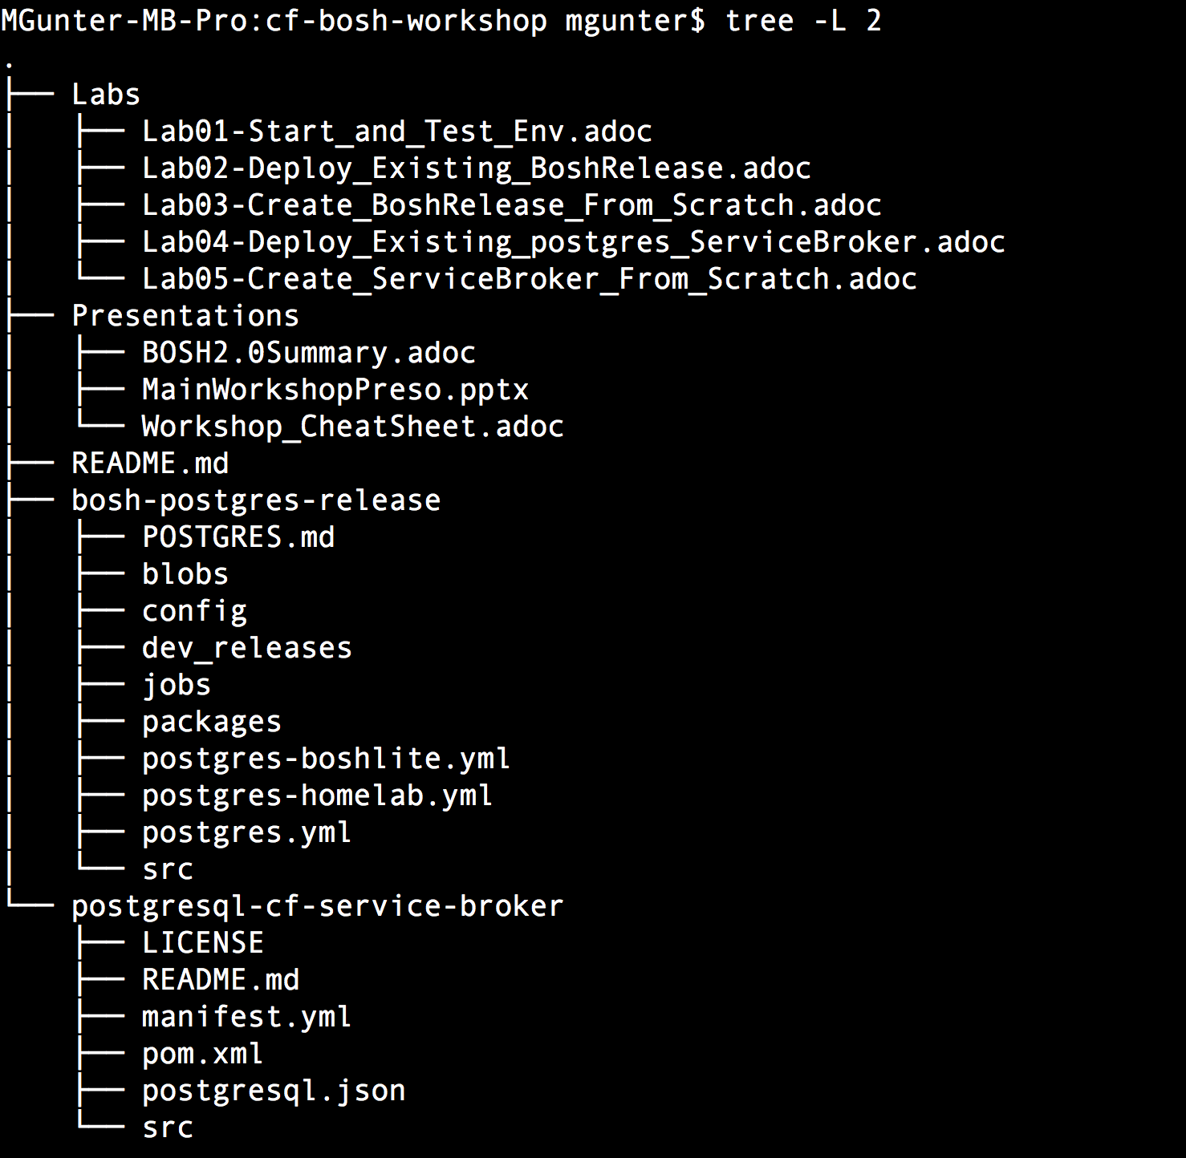
Workshop Structure

Slide 7
Introducing BOSH concepts

Slide 8
What is BOSH?
“…BOSH is able to solve problems such as “how does one make sure that the compiled version of the software is reliably available throughout the deploy”, or “how to version and roll out updated software to the whole cluster, VM-by-VM, that other orchestration software is not able to solve”
Notes:
BOSH allows individual developers and teams to easily version, package and deploy software in a reproducible manner.
Any software, whether it is a simple static site or a complex multi-component service, will need to be updated and repackaged at some point. This updated software might need to be deployed to a cluster, or it might need to be packaged for end-users to deploy to their own servers. In a lot of cases, the developers who produced the software will be deploying it to their own production environment. Usually, a team will use a staging, development, or demo environment that is similarly configured to their production environment to verify that updates run as expected. These staging environments are often taxing to build and administer. Maintaining consistency between multiple environments is often painful to manage.

Slide 9
4 principles of modern Release Engineering
Identifiability: Being able to identify all of the source, tools, environment, and other components that make up a particular release.
Reproducibility: The ability to integrate source, third party components, data, and deployment externals of a software system in order to guarantee operational stability
Notes:
BOSH was purposefully constructed to address the four principles of modern Release Engineering:
Identifiability: BOSH has a concept of a software release which packages up all related source code, binary assets, configuration etc. This allows users to easily track contents of a particular release. In addition to releases BOSH provides a way to capture all Operating System dependencies as one image
Reproducibility: BOSH tool chain provides a centralized server that manages software releases, Operating System images, persistent data, and system configuration. It provides a clear and simple way of operating a deployed system.

Slide 10
4 principles of modern Release Engineering
Consistency: the mission to provide a stable framework for development, deployment, audit, and accountability for software components.
Agility: the ongoing research into what are the repercussions of modern software engineering practices on the productivity in the software cycle, i.e. continuous integration.
Notes:
Consistency: BOSH software releases workflows are used throughout the development of the software and when the system needs to be deployed. BOSH centralized server allows users to see and track changes made to the deployed system
Agility: BOSH tool chain integrates well with current best practices of software engineering (including Continuous Delivery) by providing ways to easily create software releases in an automated way and to update complex deployed systems with simple commands.

Slide 11
Purpose-built for “Day 2 Operations”
Consistent, Reliable, Scalable, Secure
Provision
Deploy and Configure
Checks against “desired state” to return consistency
No ad hoc automation burden
Manage services, not servers
Self Healing
Current
State
Desired
State
Re-mediate
Monitor and Detect

Slide 12
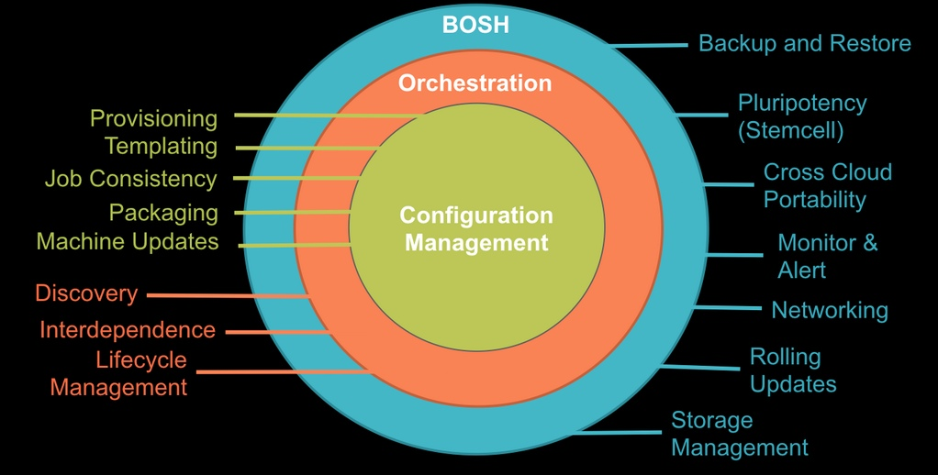
Designed to “rule them all”
Provision services, not machines
Enables continuous delivery
Cloud-agnostic view of Platform Ops
Holistic Toolchain for “rule them all"
Eliminate bespoke automation on top of config management
Notes:
Developer/operator communities have come far in solving similar situations with tools like Chef, Puppet, and Docker. However, each organization solves these problems in a different way, which usually involves a variety of different, and not necessarily well-integrated, tools. While these tools exist to solve the individual parts of versioning, packaging, and deploying software reproducibly, BOSH was designed to do each of these as a whole.

Slide 13


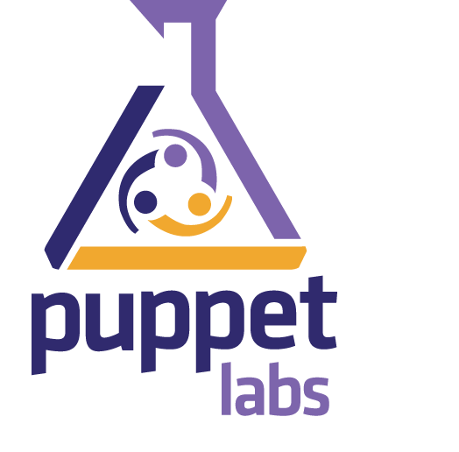
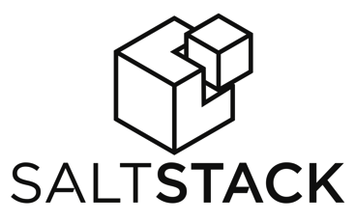
CM & Orchestration tools

Slide 14
What is missing?
These tools were designed to ensure servers are in a desired configuration, not to rapidly deploy software.
Coordinating actions across different systems is left up to the user, requiring scripts or other tools.
Manage services …not servers or VMs

Slide 15
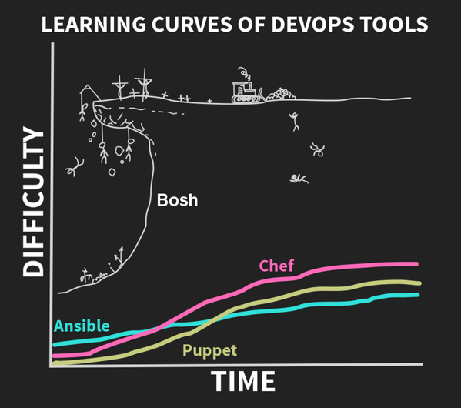
Learning curves of DevOps Tools

Slide 16
BOSH & Cloud Foundry
apps
Cloud
Foundry
services
containers
BOSH
VMs
IaaS
Hardware

Slide 17

The BOSH Architecture
Director
DB
Blobstore
CLI
Workers
NATS
Health Monitor
CPI
Agents
DB
Blob Store
CLI
Director
Worker
NATS
Health Monitor
CPI
Inner shell
Agents
Outer shell

Slide 18



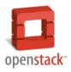


BOSH: Cloud Provider Interface
Stemcell
create_stemcell(image, cloud_properties)
delete_stemcell(stemcell_id)
VM
create_vm(agent_id, stemcell_id, resource_pool,
networks, disk_locality, env)
delete_vm(vm_id)
reboot_vm(vm_id)
configure_networks(vm_id, networks)
Disk
create_disk(size, vm_locality)
delete_disk(disk_id)
attach_disk(vm_id, disk_id)
detach_disk(vm_id, disk_id)
IaaS Neutral
...ETC

Slide 19
LAB 1:
Setting up & Testing a BOSH Director (bosh-lite)

Slide 20
BOSH-Lite
BOSH Lite is a pre-built Vagrant box which includes the Director. It uses containers to emulate VMs which makes it an excellent choice for:
General BOSH exploration without investing time and resources to configure an IaaS
Development of releases (including BOSH itself)
Testing releases locally or in CI

Slide 21
Setting up a BOSH Director
Install Vagrant
Spin up a BOSH-Lite VM
Target our new environment
Check BOSH-Lite status

Slide 22
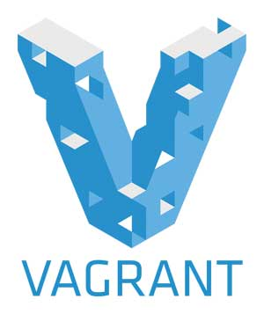
1. Install Vagrant
Download and install Vagrant
https://www.vagrantup.com/
Install Virtual Box
Install Vagrant Vbox Plugin

Slide 23
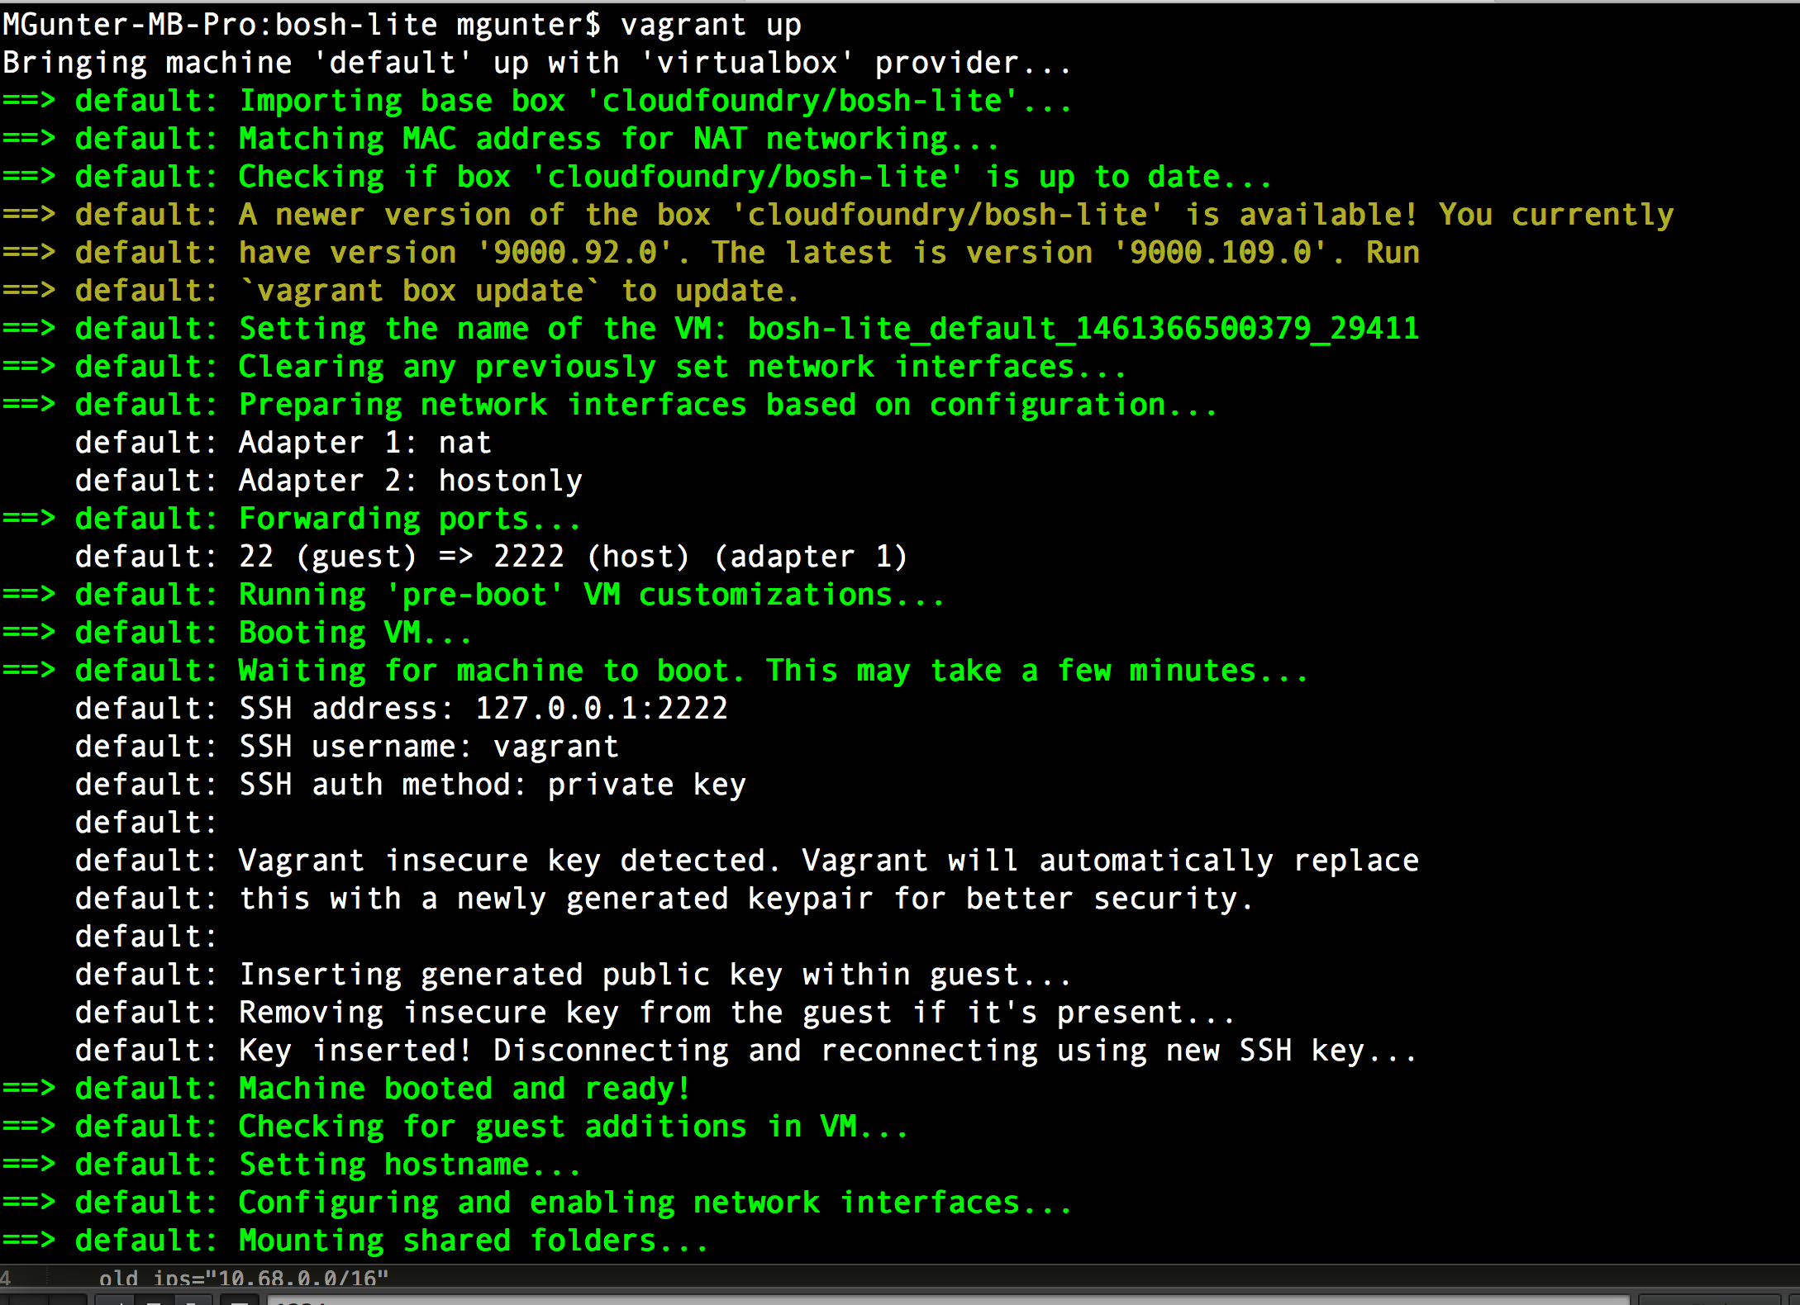
2. Spin up a BOSH Lite VM
vagrant up –provider=virtualbox

Slide 24
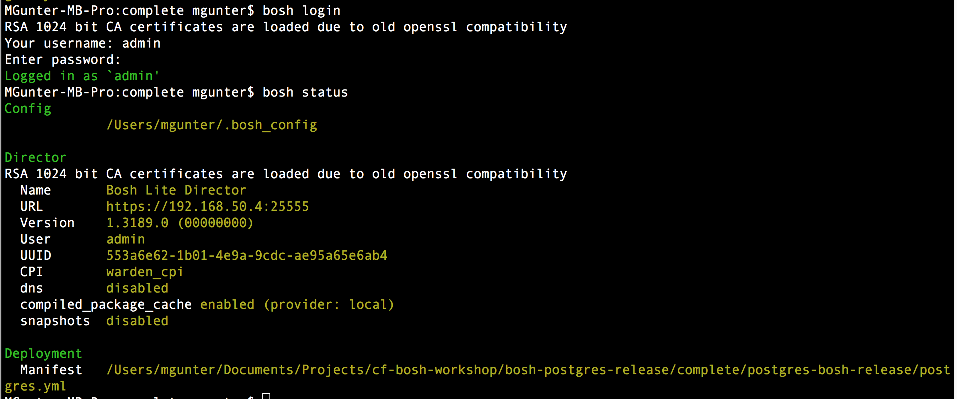
3. Target our new environment
vagrant ssh
bosh target 192.168.50.4
bosh login ( use: admin /admin)

Slide 25
4. Check BOSH-Lite status
bosh status

Slide 26
Setting up a pcfdev environment
Install Vagrant
Spin up a PcfDev VM
Login to our new environment
Check CF status

Slide 27
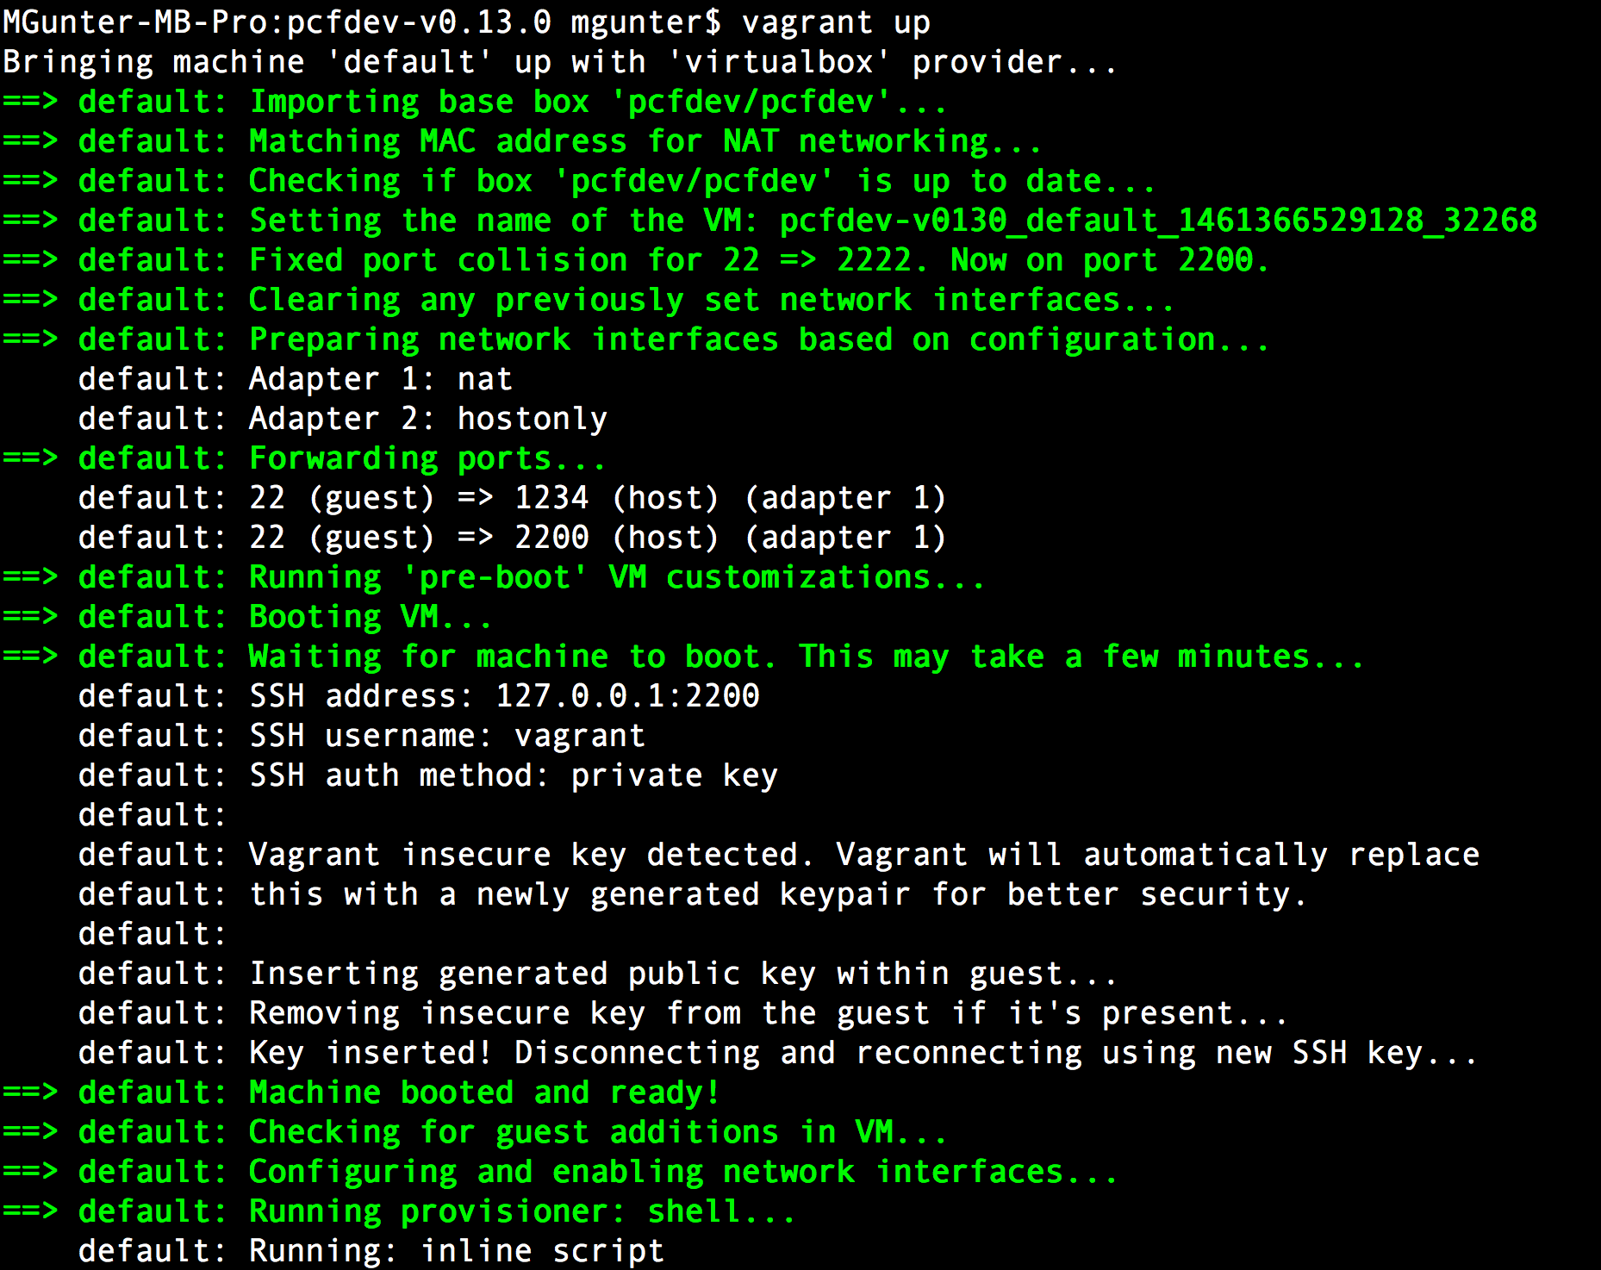
2. Spin up a pcfdev VM
vagrant up –provider=virtualbox

Slide 28
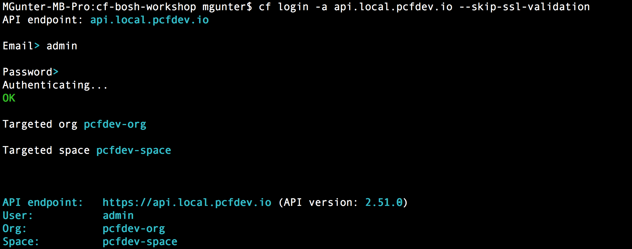
3. Login to our new environment
cf login -a api.local.pcfdev.io --skip-ssl-validation
admin
admin

Slide 29
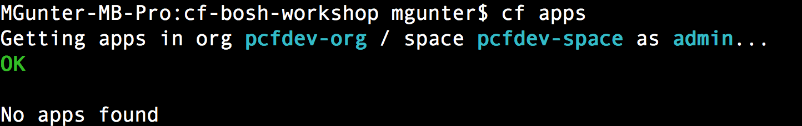
4. Check PcfDev status
cf apps

Slide 30
Need to cover
Bosh init
Bosh generate jobs
Bosh generate packages
Bosh create Release
Bosh upload release
Directory Structure, versioning, template, monit, etc.

Slide 31
LAB 1:Set up
and Verify
bosh-lite
and pcfdev

Slide 32
Anatomy of a BOSH deployment

Slide 33


What is a BOSH deployment?
An encapsulation of software and configuration to be deployed to the cloud.
In BOSH terminology, an encapsulation of software releases and configuration declared via a manifest file to be deployed on VMs built from stemcells.
Manifest
Stemcell
Release
Notes:
A deployment is a collection of VMs, built from a stemcell, that has been populated with specific releases and disks that keep persistent data. These resources are created based on a manifest file in the IaaS and managed by the BOSH Director, a centralized management server.
The deployment process begins with deciding which Operating System images (stemcells) need to be used and which software (releases) need to be deployed, how to track persistent data while a cluster is updated and transformed, and how to automate steps of deploying images to an IaaS; this includes configuring machines to use said image, and placing correct software versions onto provisioned machines. BOSH builds upon previously introduced primitives (stemcells and releases) by providing a way to state an explicit combination of stemcells, releases, and operator-specified properties in a human readable file. This file is called a deployment manifest.
When a deployment manifest is uploaded to a BOSH Director, requested resources are allocated and stored. These resources form a deployment. The deployment keeps track of associated VMs and persistent disks that are attached to the VMs. Over time, as the deployment manifest changes, VMs are replaced and updated. However, persistent disks are retained and are re-attached to the newer VMs.

Slide 34
What is a stemcell?
A versioned Operating System image wrapped with IaaS specific packaging
Contains a bare minimum OS skeleton with a few common utilities, a BOSH agent, and a few configuration files to securely configure the OS
Stemcells do no contain any specific information about any software that will be installed
Notes:
A stemcell is a versioned Operating System image wrapped with IaaS specific packaging.
A typical stemcell contains a bare minimum OS skeleton with a few common utilities pre-installed, a BOSH Agent, and a few configuration files to securely configure the OS by default. For example: with vSphere, the official stemcell for Ubuntu Trusty is an approximately 500MB VMDK file. With AWS, official stemcells are published as AMIs that can be used in your AWS account.
Stemcells do not contain any specific information about any software that will be installed once that stemcell becomes a specialized machine in the cluster; nor do they contain any sensitive information which would make them unable to be shared with other BOSH users. This clear separation between base Operating System and later-installed software is what makes stemcells a powerful concept.
In addition to being generic, stemcells for one OS (e.g. all Ubuntu Trusty stemcells) are exactly the same for all infrastructures. This property of stemcells allows BOSH users to quickly and reliably switch between different infrastructures without worrying about the differences between OS images.
The Cloud Foundry BOSH team is responsible for producing and maintaining an official set of stemcells. Cloud Foundry currently supports Ubuntu Trusty and CentOS 6.5 on vSphere, AWS, OpenStack, and vCloud infrastructures.
Stemcells are distributed as tarballs.
By introducing the concept of a stemcell, the following problems have been solved:
Capturing a base Operating System image
Versioning changes to the Operating System image
Reusing base Operating System images across VMs of different types
Reusing base Operating System images across different IaaS

Slide 35
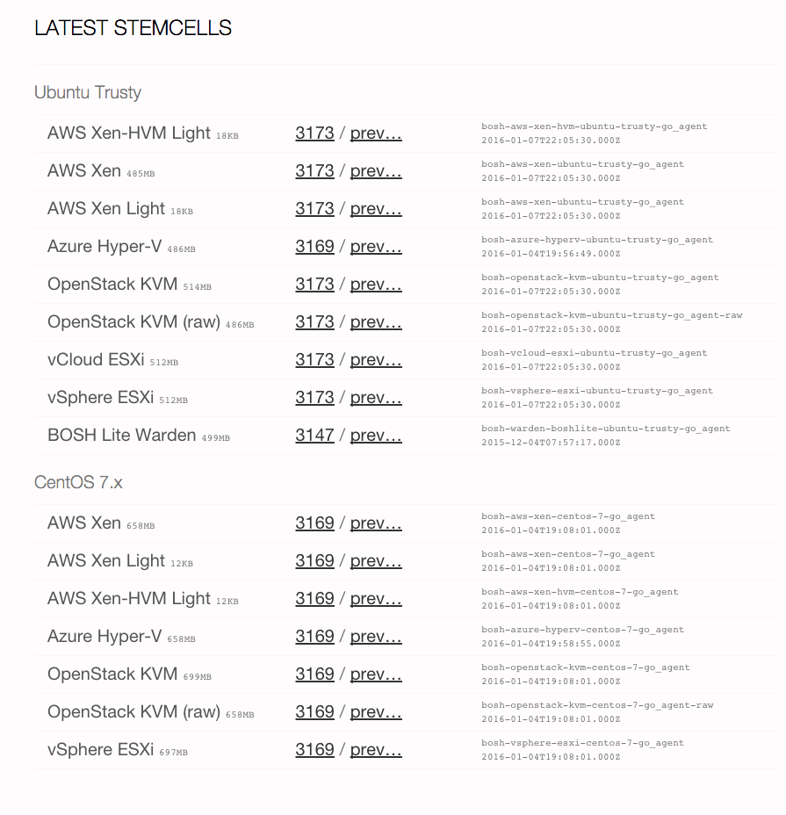
Available stemcells
http://bosh.io/stemcells

Slide 36
What is a release?
A versioned collection of source code, binary artifacts, configuration templates, and anything else required to build and deploy software in a reproducible way
Ultimatelly, a release is the layer placed on top of a stemcell
Releases should not be tied to a particular IaaS and stemcell and should not depend on internet access
Notes:
A release is a versioned collection of configuration properties, configuration templates, start up scripts, source code, binary artifacts, and anything else required to build and deploy software in a reproducible way.
A release is the layer placed on top of a stemcell. They are self-contained and provide very specific software for the purpose of that release. For example, a Redis release might include start-up and shutdown scripts for redis-server, a tarball with Redis source code obtained from the Redis official website, and a few configuration properties allowing cluster operators to alter that Redis configuration.
By allowing layering of stemcells and releases, BOSH is able to solve problems such as “how does one make sure that the compiled version of the software is reliably available throughout the deploy”, or “how to version and roll out updated software to the whole cluster, VM-by-VM, that other orchestration software is not able to solve”.
There are two common formats in which releases are distributed: artifacts checked into a git repository and as a single tarball.
By introducing the concept of a release, the following concerns are addressed:
Capturing all needed configuration options and scripts for deployment of the software
Recording and keeping track of all dependencies for the software
Versioning and keeping track of software releases
Creating releases that can be IaaS agnostic
Creating releases that are self-contained and do not require internet access for deployment

Slide 37
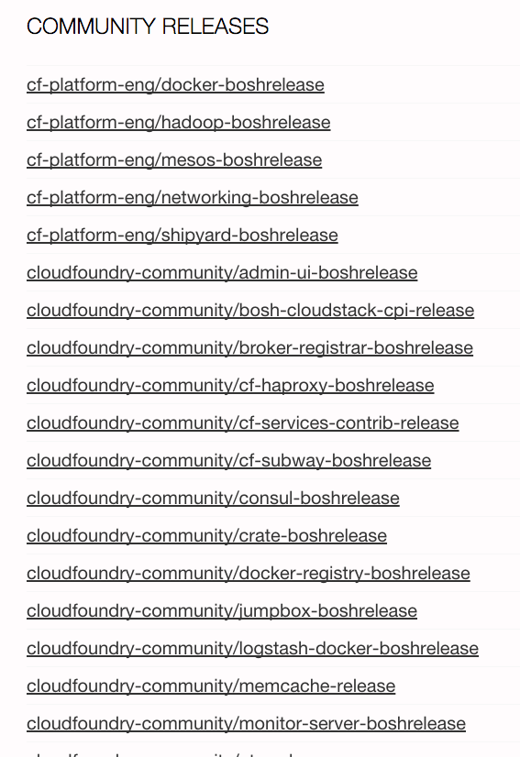
Available releases
http://bosh.io/releases
Notes:
A stemcell is a versioned Operating System image wrapped with IaaS specific packaging.
A typical stemcell contains a bare minimum OS skeleton with a few common utilities pre-installed, a BOSH Agent, and a few configuration files to securely configure the OS by default. For example: with vSphere, the official stemcell for Ubuntu Trusty is an approximately 500MB VMDK file. With AWS, official stemcells are published as AMIs that can be used in your AWS account.
Stemcells do not contain any specific information about any software that will be installed once that stemcell becomes a specialized machine in the cluster; nor do they contain any sensitive information which would make them unable to be shared with other BOSH users. This clear separation between base Operating System and later-installed software is what makes stemcells a powerful concept.
In addition to being generic, stemcells for one OS (e.g. all Ubuntu Trusty stemcells) are exactly the same for all infrastructures. This property of stemcells allows BOSH users to quickly and reliably switch between different infrastructures without worrying about the differences between OS images.
The Cloud Foundry BOSH team is responsible for producing and maintaining an official set of stemcells. Cloud Foundry currently supports Ubuntu Trusty and CentOS 6.5 on vSphere, AWS, OpenStack, and vCloud infrastructures.
Stemcells are distributed as tarballs.
By introducing the concept of a stemcell, the following problems have been solved:
Capturing a base Operating System image
Versioning changes to the Operating System image
Reusing base Operating System images across VMs of different types
Reusing base Operating System images across different IaaS

Slide 38
What is a deployment manifest?
A YAML file that identifies one or more releases, one or more stemcells and specifies how to orchestrate and configure them for a given deployment

Slide 39
Anatomy of a deployment manifest
Deployment identification
Releases
Networks
Resource Pools
Disk Pools
Jobs
Compilation
Update
Properties

Slide 40
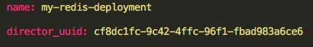
Deployment Identification
Identifies the name of the deployment and the BOSH Director to be used
Deployment name
BOSH Director UUID

Slide 41
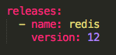
Releases
Identifies a collection of releases (name and version) we want to deploy
Release name
Release version

Slide 42
Networks
A BOSH network is an IaaS-agnostic representation of the networking layer. There are three types of networks that BOSH supports:
Manual: BOSH decides how to assign IPs
Dynamic: BOSH defers IP selection to the IaaS
VIP: Virtual IP address

Slide 43
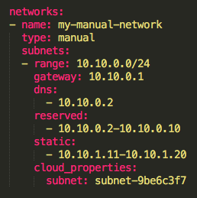
Manual networks
Manual networking allows you to specify one or more subnets and let BOSH choose available IPs from one of the subnet ranges
Network name
Network type
Network IP range
Network gateway IP address
DNS IP addresses for this network
IPs that will not be used
IPs that can only be used for static IP reservations
Specific IaaS Properties

Slide 44
Manual networks
10.10.0.0/24
10.10.0.1
Gateway: BOSH will configure each VM with this gateway
10.10.0.2
…
Reserved range: BOSH will NOT use these IP addresses
10.10.0.10
10.10.0.11
Static range: BOSH will ONLY use these IP addresses
when the job explicitely set one
…
10.10.0.20
10.10.0.21
…
Dynamic range: BOSH will use use these IP addresses
when the job does NOT explicitely set one
10.10.0.254
10.10.0.255
Broadcast: BOSH will NOT use this IP address

Slide 45
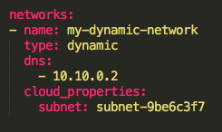
Dynamic networks
Dynamic networking defers IP selection to the IaaS
Network name
Network type
DNS IP addresses for this network
Specific IaaS Properties

Slide 46
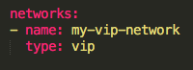
VIP networks
VIP networking enables the association of a virtual IP address that is not backed by any particular NIC
Network name
Network type

Slide 47
IP reservation types
 | Manual | Dynamic | VIP
Static IP assignment | Supported | Not supported | Supported
Automatic IP assignment | Supported | Supported | Not Supported
Static: IP is explicitly requested by the user in the deployment manifest
Automatic: IP is selected automatically based on the network type

Slide 48
Multi-networks
IaaS | Manual | Dynamic | VIP
AWS | Single per job instance | Single per job instance | Single per job instance
OpenStack | Multiple per job instance | Single per job instance | Single per job instance
vSphere | Multiple per job instance | Not supported | Not supported
vCloud | Multiple per job instance | Not supported | Not Supported

Slide 49
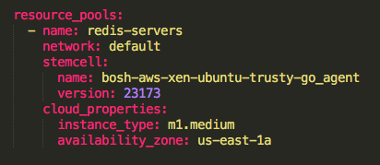
Resource Pools
Identifies a collection of VM specifications
Resource Pool name
Network to use
Stemcell (name and version)
Specific IaaS Properties

Slide 50
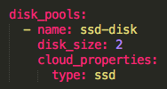
Disk Pools
Identifies a collection of disk specifications
Disk Pool name
Disk size (Mb)
Specific IaaS Properties

Slide 51
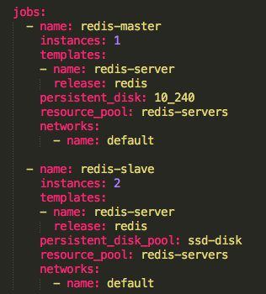
Jobs
A job is a composition of configuration and installed software on a particular VM
Name of the jobs
# of instances of this particular job
Release to be deployed and release process
Persistent disk or disk pool
Resource pool
Network

Slide 52
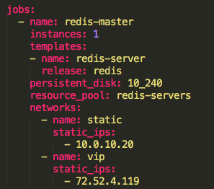
Job’s networks
Depending on the job’s network, additional properties might be configured
Manual networks allows to specify the desired private IP address(es)
VIP networks require to specify the public IP address(es)

Slide 53
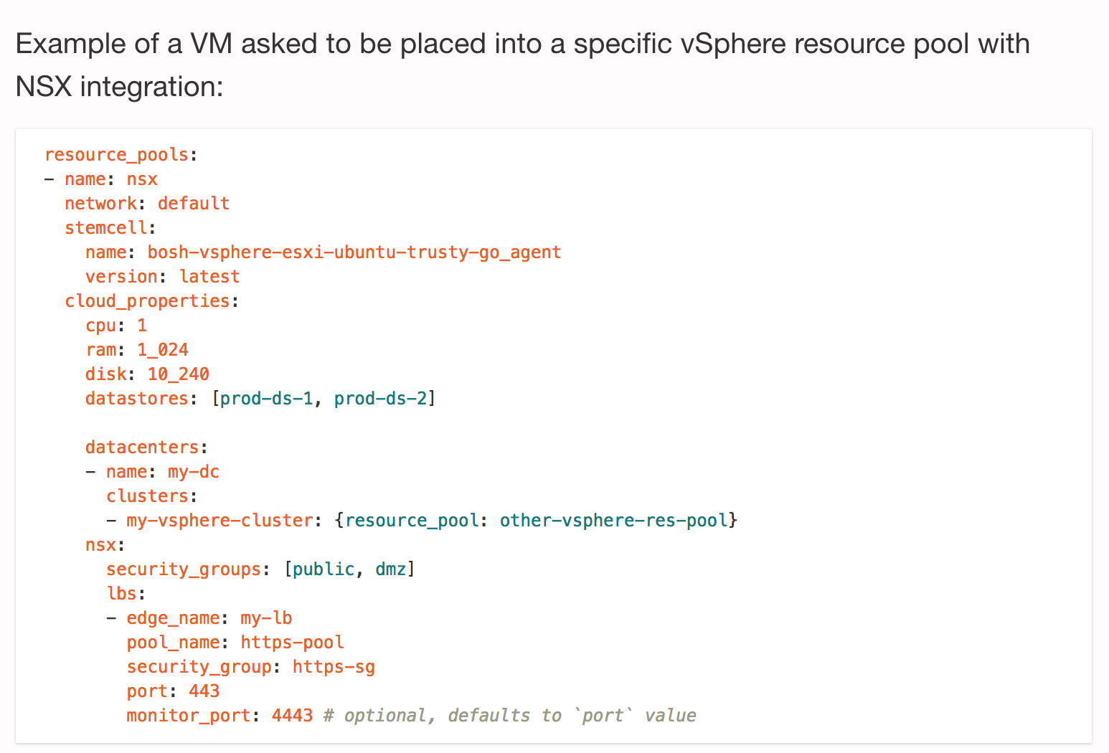

Slide 54
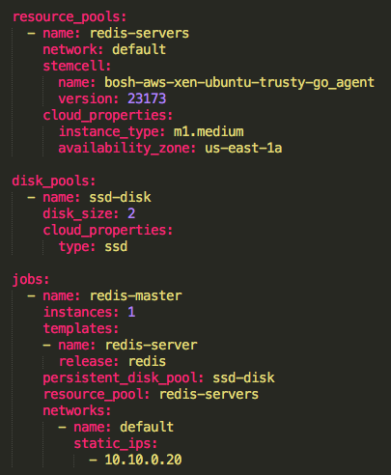
Jobs
Job
redis-servers
Instance 1
2Mb
SSD Disk
Ubuntu Trusty (23173)
m1.medium VM at us-east-1a
with IP address 10.10.0.20

Slide 55
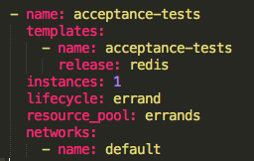
Job types
Service (default): runs indefinitely and restarts if it fails
Errand: starts with a manual trigger and does not restart if it fails
Job type

Slide 56
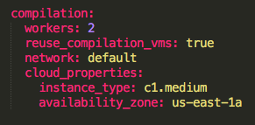
Compilation
Compilation VMs are ephemeral instances where the source code from a release package is converted to a binary compatible with the stemcell
# of compilation VMs
If VMs are re-used when compiling other packages
Network
Specific IaaS Properties

Slide 57
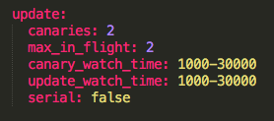
Update
Describes how BOSH updates job instances during the deployment
# of canary instances
Max # of non-canary instances to update in parallel
Wait time (ms) to check whether canary instances are healthy
Wait time (ms) to check whether instances are healthy
How jobs are updated (serial or parallel)

Slide 58

Canary Instances
Canary instances are instances updated before other instances. Any update error in a canary instance causes the deployment to stop. Since only canary instances are affected before an update stops, problematic packages or jobs are prevented from taking over all job instances.
Canaries are Great! - https://blog.pivotal.io/pivotal-cloud-foundry/products/canaries-are-great

Slide 59


How do the Canary deployment works?
Current state: v1

Slide 60

How do the Canary deployment works?
Canaries
Canary instances are updated to v1.1
The rest of instances are still on v1.0

Slide 61

How do the Canary deployment works?
Canaries
If canary instances fail, the rest of instances are not affected
Failed canary instances are kept for troubleshotting purposes

Slide 62

How do the Canary deployment works?
MAX_IN_FLIGHT
INSTANCES
If canary instances succeed, the rest of instances
are updated on chunks based on max_in_flight

Slide 63
How do the Canary deployment works?
Current state: v1.1

Slide 64
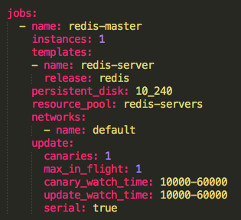
Update
Global update properties can be overriden for a particular job

Slide 65
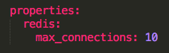
Properties
Describes the global properties in order to configure jobs for a specific environment

Slide 66
Properties precedence
BOSH applies the properties in the release template spec file to the job.
If an identically named property exists in the Properties block of the deployment manifest, the value of this property overrides the previous value.
If an identically named property exists in the Properties sub-block of the Jobs block of the deployment manifest, the value of this property overrides all previous values.

Slide 67
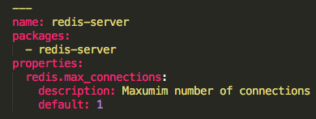
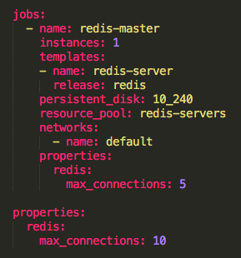
Properties order
Release template spec
Deployment manifest
3
1
Job properties
1
2
Global properties
3
Release template default
2

Slide 68
Changing the deployment manifest
An update of a release or stemcell version will trigger the compilation of (newer) packages and the update of the affected jobs
An update of a network properties might trigger a VM recreation (ie: modifying the network security group)
An update of a resource pool’s properties or a job’s resource pool will trigger a VM recreation
An update of a job’s network will trigger a VM recreation
An update of a job’s property will trigger the update of the job

Slide 69
Persistent disk considerations
Everything inside a VM is considered ephemeral except any attached persistent disk
A VM recreation will keep all data from the persistent disk intact
An update of the size and/or type of a persistent disk will trigger a migration of the data to a new persistent disk

Slide 70

Persistent disks
A PD is attached to a VM
If the VM is deleted, the PD remains
The old PD is reattached to the new VM
PD
PD
PD

Slide 71
Persistent disk migration
A new PD is created with the new properties
The new PD is attached to the VM
The BOSH agent migrates the data from the old PD to the new PD
The old PD is detached and deleted
PD
PD
PD
PD
PD
PD
PD
PD

Slide 72
BOSH documentation
http://bosh.io/docs

Slide 73
LAB 2:
Deploying an Existing Bosh Release

Slide 74
Deploying Postgresql (cf-postgres)
Create a Release (cf-postgres)
Upload a BOSH stemcell (warden/ubuntu)
Upload the cf-postgres BOSH release
Create a BOSH deployment manifest (postgres.yml)
Set the BOSH deployment manifest
Deploy
Update the BOSH deployment manifest
Deploy changes

Slide 75
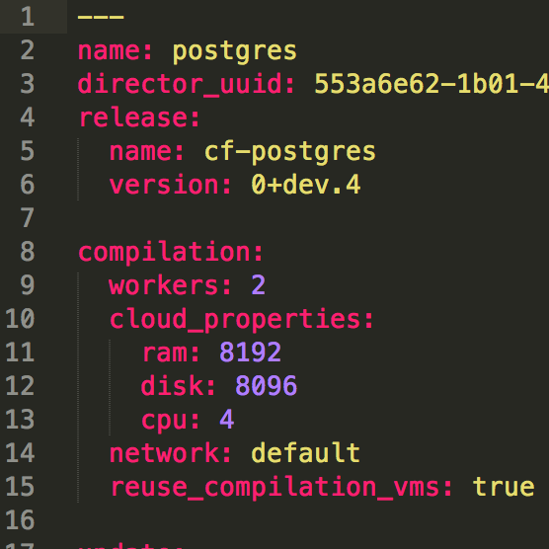
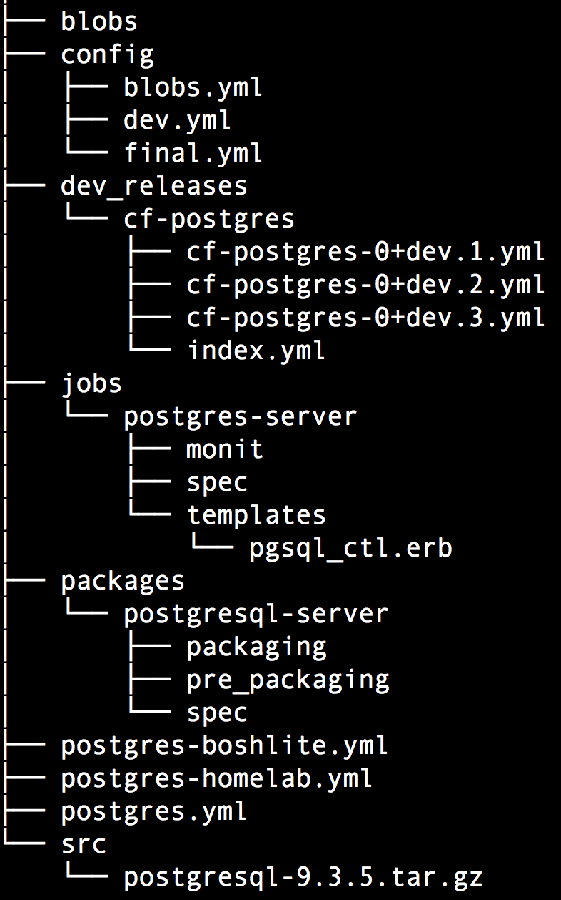
Lab 2: Big Picture
Deployment Manifest -postgres.yml-
4. Deployment postgres.yml
5. Deploy
warden container
Bosh-Lite 192.168.50.4
Postgres
10.68.45.151
Start scripts
Monitoring
Postgres Release
Source
Binaries
Bosh Director
6. Complete!
VM
2. Upload Release
1. Create Release
3. Upload Stemcell
Stemcell
Bosh Agent
Secured
IaaS-specifics

Slide 76
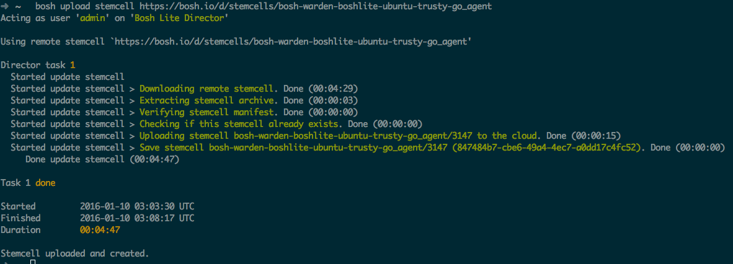
1. Upload a BOSH stemcell
bosh upload stemcell bosh-stemcell-3147-warden-boshlite-ubuntu-trusty-go_agent.tgz

Slide 77
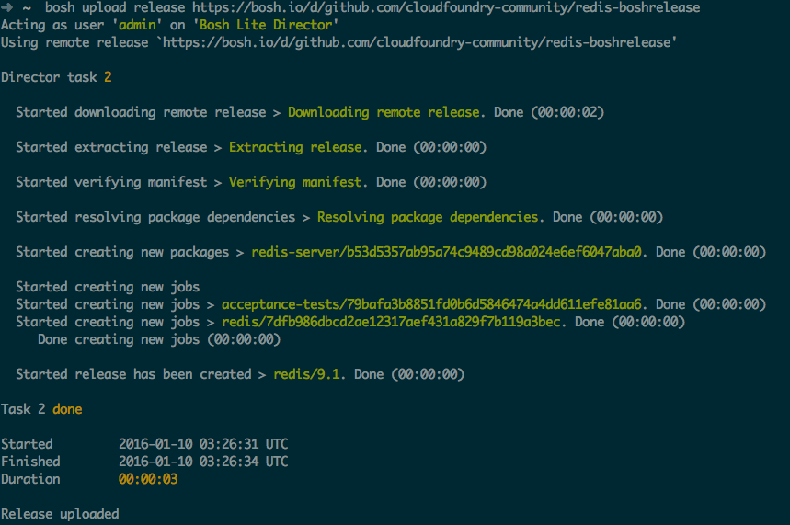
2. Upload the BOSH release
bosh upload release redis-boshrelease-9.1.tgz

Slide 78
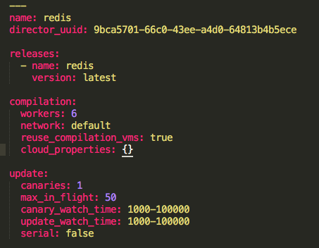
3. Create a BOSH deployment manifest
Deployment identification block
Releases block
Compilation block
Update block

Slide 79
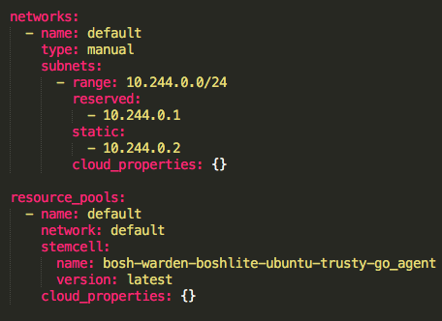
3. Create a BOSH deployment manifest
Networks block
Resource Pools block

Slide 80
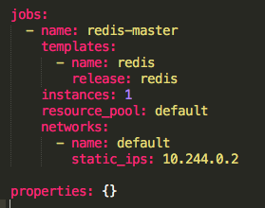
3. Create a BOSH deployment manifest
Jobs block
Properties block

Slide 81
4. Set the BOSH deployment manifest
bosh deployment redis.yml
bosh deployment postgres.yml

Slide 82
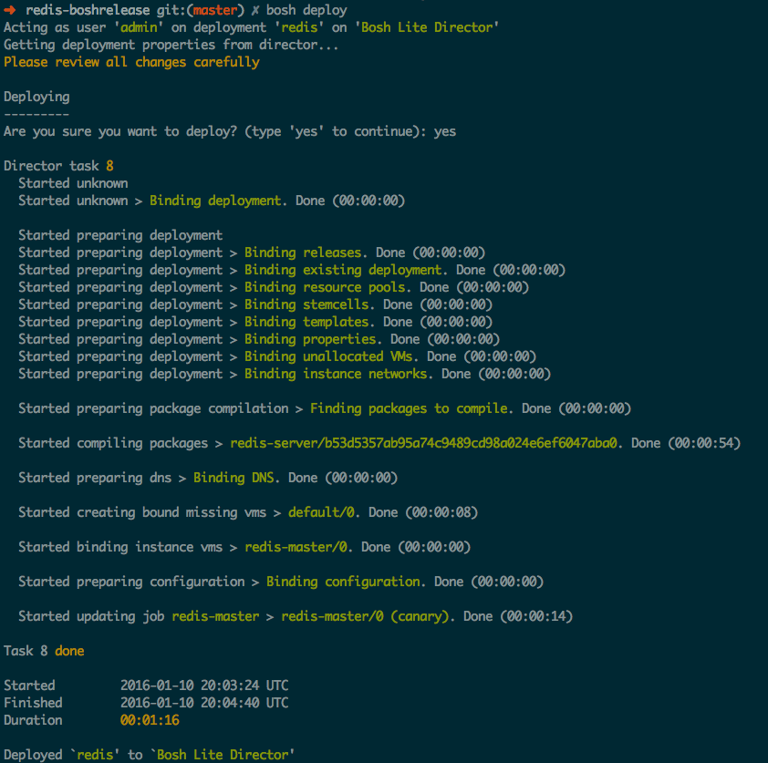
5. Deploy
bosh deploy
Checks
Compiling packages
Creating resources
Assigning a role to each resource
Deploying

Slide 83
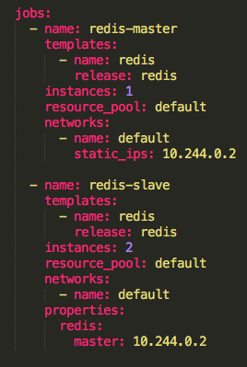
6. Update the BOSH deployment manifest
Adding a new job
# of instances
Job’s specific properties

Slide 84
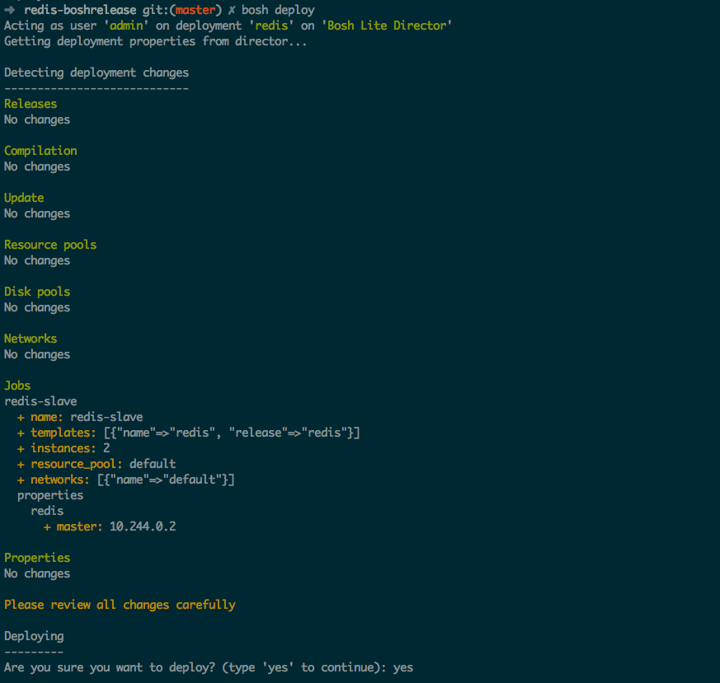
7. Deploy changes
bosh deploy
Detected changes

Slide 85
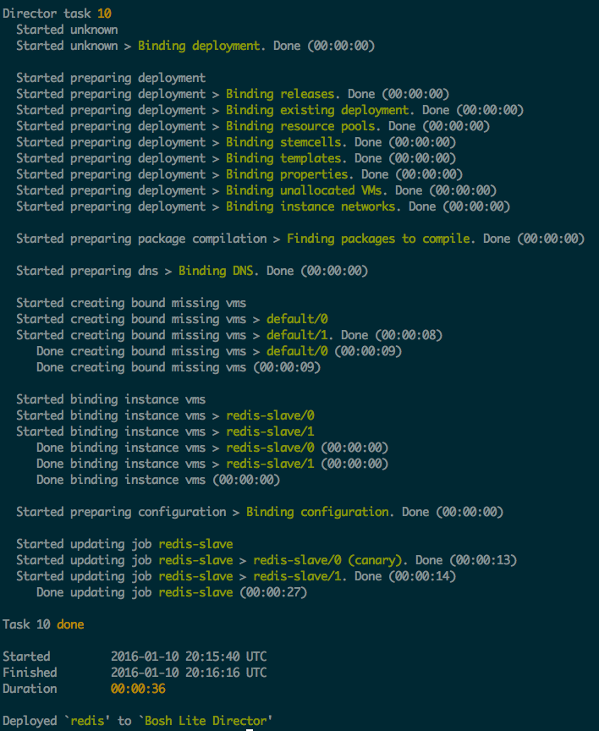
7. Deploy changes
bosh deploy
Checks
Creating missing resources
Assigning a role to each resource
Deploying

Slide 86
Troubleshooting a BOSH deployment

Slide 87
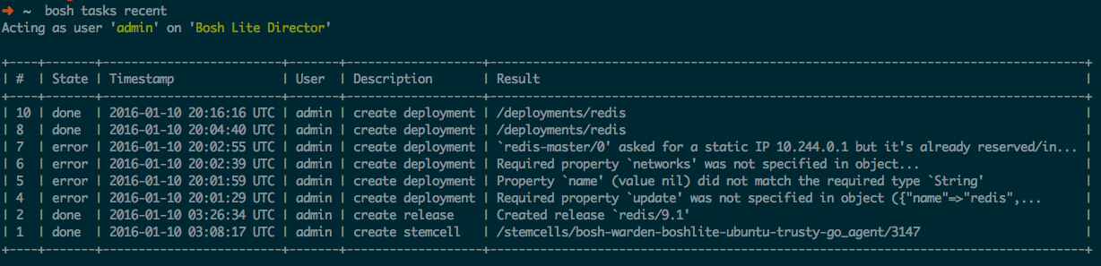
BOSH tasks
bosh tasks recent

Slide 88
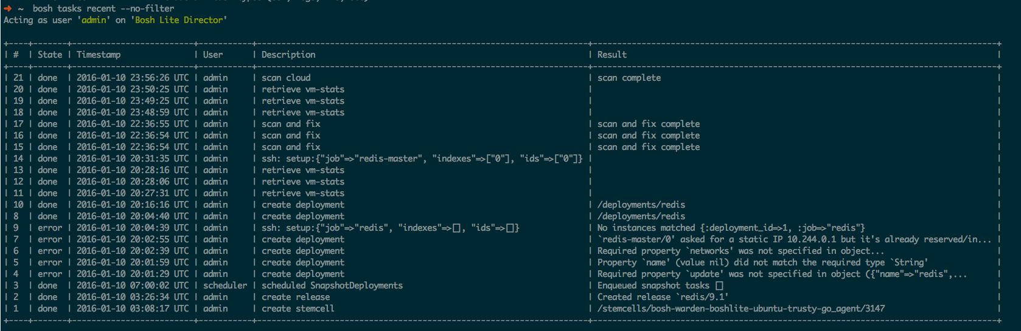
BOSH tasks
bosh tasks recent –no-filter

Slide 89
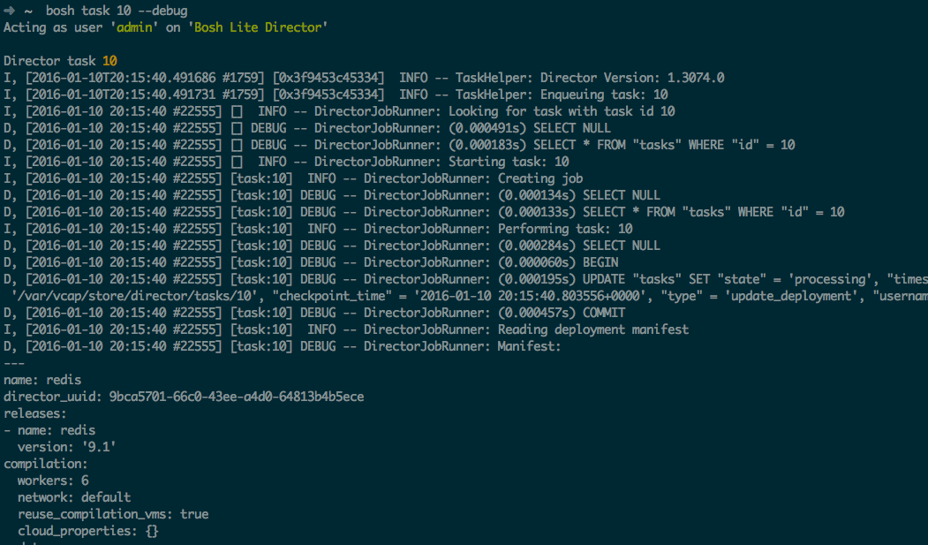
Debug a BOSH task
bosh task 10 --debug

Slide 90
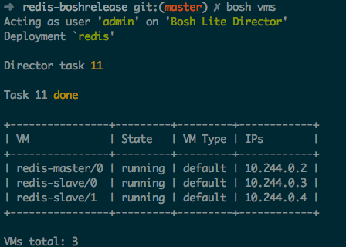
List VMs
bosh vms
running: indicates that all release job’s processes are successfully running at that moment
failing: indicates one of the release job’s processes is not successfully running (could be failing to start, or exiting after some time, etc.)
unresponsive: the Director did not receive any response from the Agent

Slide 91
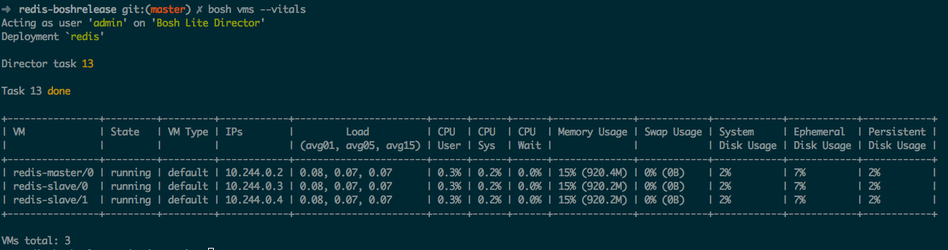
Monitor VM’s state and vitals
bosh vms --vitals

Slide 92

SSH into a VM
bosh ssh job/index
The Agent on each VM sends an alert when someone/something tries to log into the system via SSH. Successful and failed attempts are recorded.
Some IaaS set a “secret” root password. By default is “c1oudcw0” (SHHH!!!)

Slide 93

Setting a custom root password
Hashed password - Generate SHA hash using “mkpasswd -m sha-512”

Slide 94

Process health-check
“monit summary”
“monit (status|start|stop)”
https://mmonit.com/monit/

Slide 95

Process recovery in action
If a process dies, the BOSH agent will restart it again automatically

Slide 96
VM health-check
The Health Monitor continiously checks the presence of the deployed VMs.
The Agent on each VM produces a heartbeat every minute and sends it to the Health Monitor.
The Health Monitor is extended by a set of plugins. Each plugin is given an opportunity to act on each heartbeat, so in cases of failure it can notify external services or perform actions against the Director.

Slide 97
Health Monitor plugins
Event Logger: Logs events to a file
Resurrector: Recreates VMs that have stopped heartbeating
Emailer: Sends configurable e-mails on events reciept
OpenTSDB: Sends events to OpenTSDB
Graphite: Sends events to Graphite
PagerDuty: Sends events to PagerDuty.com using their API
DataDog: Sends events to DataDog.com using their API
AWS CloudWatch: Sends events to Amazon’s CloudWatch using their API
Configuring Health Monitor: http://bosh.io/docs/hm-config.html

Slide 98
Resurrector Health Monitor plugin
It’s responsible for automatically recreating VMs that become inaccessible.
It continiously cross-references VMs expected to be running against the VMs that are sending heartbeats. When resurrector does not receive heartbeats for a VM for a certain period of time, it will kick off a task on the Director (scan and fix task) to try to “resurrect” that VM.
Under certain conditions the Resurrector will consider the system in the “meltdown” and will stop sending requests to the Director.

Slide 99


Slide 100
Automatic repair with Resurrector
Redis Master
Desired State
Actual State
AGENT
Health Monitor
BOSH Director
Responses:
Redis Slave
pager
AGENT
Message Bus
email
monitoring
resurector
Redis Slave
…
AGENT
BOSH
IaaS

Slide 101
Automatic repair with Resurrector
Redis Master
Desired State
Actual State
AGENT
Health Monitor
BOSH Director
Responses:
Redis Slave
pager
AGENT
Message Bus
email
monitoring
resurector
Redis Slave
…
AGENT
BOSH
IaaS

Slide 102
Automatic repair with Resurrector
CPI
Redis Master
Desired State
Actual State
AGENT
Health Monitor
BOSH Director
Responses:
Redis Slave
pager
AGENT
Message Bus
email
monitoring
resurector
Redis Slave
…
AGENT
BOSH
IaaS

Slide 103

Manually Disabling the Resurrector
“bosh vm resurrection job index on|off”

Slide 104
Manual repair with Cloud Check
BOSH provides the Cloud Check CLI command (a.k.a cck) to repair IaaS resources used by a specific deployment. It is not commonly used while normal operations; however, it becomes essential when some IaaS operations failed and the Director cannot resolve problems without a human decision or when the Resurrector is not enabled.
VM is missing
VM is not responsive (unresponsive agent)
Persistent Disk is not attached
Persistent Disk is missing

Slide 105

Manual repair with Cloud Check
bosh cck

Slide 106
VM Configuration Locations
/var/vcap/bosh/log/current: current BOSH agent log
/var/vcap/monit/monit.log: Monit activity log. Includes information about starts, stops, restarts, etc. of release job processes monitored by Monit

Slide 107
VM Configuration Locations
/var/vcap/jobs: contains evaluated release jobs for the assigned deployment job
/var/vcap/packages: contains enabled release packages for the assigned deployment job
/var/vcap/data: used by the release jobs to keep ephemeral data
/var/vcap/store: used by the release jobs to keep persistent data

Slide 108
VM Configuration Locations
/var/vcap/sys/run: directory that is used by the release jobs to keep miscellaneous ephemeral data about currently running processes, for example, pid and lock files
/var/vcap/sys/log: directory that is used by the release jobs to keep logs

Slide 109
Log rotation
BOSH log rotates release job logs with the Logrotate log file management utility with the following non-configurable settings:
missingok: Skip missing log files and do not generate an error message
rotate 7: Keep seven log files at a time
compress: Compress old log files with gzip
delaycompress: Postpone compression of log files until the next rotation cycle
copytruncate: Copy log files, then truncate in place instead of creating new files
size 50M: Rotate log files when they exceed 50 MB in size.

Slide 110
Anatomy of a BOSH release

Slide 111
What is a release?
A versioned collection of source code, binary artifacts, configuration templates, and anything else required to build and deploy software in a reproducible way
Ultimatelly, a release is the layer placed on top of a stemcell

Slide 112
Elements of a release
Jobs: describes pieces of the service or application you are releasing
Packages: provides software to jobs
Source: provides packages the non-binary files they need
Blobs: provide packages the binaries they need, other than binaries that are checked into a source code repository

Slide 113

What is a package?
A Package provides executables, source code and dependencies to jobs
It should not be tied to a particular stemcell and should not depend on internet access
Never depend on the presence of libraries or other software on stemcells
It is composed of a source code and/or a blob and instructions on how to build it

Slide 114

Package’s spec file
Package name
Package’s dependencies (at compile time)
The location where BOSH can find the binaries and other files that the package needs at compile time.
BOSH interprets the locations you record in the files section as being relative either in the “src” directory or in the “blobs” directory

Slide 115

Package’s packaging script
Ensure that any copying, installing or compiling delivers resulting code to the install target directory

Slide 116


Package’s dependency graph
Be aware that BOSH ensures that dependencies cited in the dependencies block of package spec files are available to the deployed binary, but only at compile time

Slide 117

Sources
Provides packages with the non-binary files they need
We store them at the “src” directory
Use the globbing pattern <package_name>/**/* to deep-traverse the directory in src where the source code should reside

Slide 118
Blobs
Packages often use tar files or other binaries, also known as blobs
Checking blobs into a repository is problematic if your repository is unsuited to dealing with large binaries (as is true of Git, for example)
We store them at the “blobs” directory

Slide 119
Configuring a blobstore
In the config directory, you record the information BOSH needs about the blobstore:
The final.yml file names the blobstore and declares its type, which is either local or one of several other types that specify blobstore providers.
The private.yml file specifies the blobstore path, along with a secret. It contains keys for accessing the blobstore and should not be checked into a repository.

Slide 120

final.yml example for AWS S3 blobstore
Release name
Blobstore type
Specific blobstore configuration

Slide 121

private.yml example for AWS S3 blobstore
Specific blobstore configuration
Never check this file into a repository!!!

Slide 122
What is a job?
A job describe pieces of the service or application you are releasing:
What packages depends on
How to start/stop it
How to monitor it
What properties can be configured

Slide 123
Elements of a Job
Spec: describes the job specification (package’s dependencies, templates and properties)
Monit: describes how to run the job’s processes
Templates: control scripts, configuration files, …

Slide 124

Spec file
Job name
Job’s package dependencies
Job’s template

Slide 125

Spec file
Property name
Property description
Property default value

Slide 126

Monit file
Process name
How to monitor the process
How to start/stop the process
Ownership of the process

Slide 127

Templates

Slide 128
Special scripts
bin/pre-start: will run before the job is started. This script allows the job to prepare machine and/or persistent data before starting its operation.
bin/drain: will run when the job is restarted or stopped. This script allows the job to clean up and get into a state where it can be safely stopped
bin/run: will run a job’s errand

Slide 129
Lab 3: Creating a Bosh Release "from scratch"

Slide 130




Anatomy of a BOSH release
Release
Job
Stemcell
Monit script
OS Process
OS Process
Instantiated in runtime based on
OS Process
Agent
Monit
Monit
Monit
Scripts:
Depends
src
Packaging
Depends
Packages
Pre-Packaging
Depends
Blobs
Depends

Slide 131


Lab 3: Big Picture
Create Jobs, Packages, Scripts and Assemble them into a new Release

Slide 132

Atlassian Bamboo
https://www.atlassian.com/software/bamboo/

Slide 133

Installing Bamboo on Linux
https://confluence.atlassian.com/bamboo/installing-bamboo-on-linux-289276792.html

Slide 134

1. Generate the release skeleton
bosh init release bamboo-boshrelease

Slide 135

2. Download the Java8 binaries
http://www.linuxfromscratch.org/blfs/view/svn/general/java.html

Slide 136

3. Download the Bamboo server binaries
https://www.atlassian.com/software/bamboo/downloads/binary/atlassian-bamboo-5.9.7.tar.gz

Slide 137

4. Generate the Java8 package
bosh generate package java8

Slide 138


5. Fill the Java8 package

Slide 139

6. Generate the Bamboo server package
bosh generate package bamboo-server

Slide 140


7. Fill the Bamboo server package

Slide 141

8. Generate the Bamboo server job
bosh generate job bamboo-server

Slide 142

9. Create a Bamboo server control script

Slide 143

10. Fill the Bamboo server monit file

Slide 144

11. Fill the Bamboo server spec file

Slide 145

12. Generate a dev release
bosh create release --force

Slide 146

13. Upload the dev release
bosh upload release /Users/frodenas/Development/bamboo-boshrelease/dev_releases/bamboo/bamboo-0+dev.1.yml

Slide 147


14. Generate a deployment manifest

Slide 148

15. Deploy
bosh deployment bamboo.yml
bosh deploy

Slide 149

16. Fix the release

Slide 150

17. Create dev release and upload it
bosh create release –force
bosh upload release /Users/frodenas/Development/bamboo-boshrelease/dev_releases/bamboo/bamboo-0+dev.2.yml

Slide 151

18. Redeploy
bosh deploy

Slide 152

19. Success!!!
http://10.244.0.2:8085/

Slide 153

Creating a final release
bosh upload blobs
bosh create release --final
config/final.yml
config/private.yml

Slide 154

Creating a release tarball
bosh create release –with-tarball release.yml

Slide 155
Pivotal OpsManager and BOSH

Slide 156





Pivotal OpsManager
Pivotal OpsManager is a web UI that installs and then sits on top of BOSH
BOSH
IaaS

Slide 157

Pivotal OpsManager
Click to install & update

Slide 158

Pivotal OpsManager
Simple interface allows a streamlined set up and configuration

Slide 159

Pivotal OpsManager
Built-in platform monitoring

Slide 160

Pivotal OpsManager
Credentials management

Slide 161

Pivotal OpsManager
Explore install logs

Slide 162

Pivotal OpsManager
Scale the platform

Slide 163

Pivotal OpsManager
Easily import new products

Slide 164









Pivotal Network
Pivotal Network provides a rich set of products for Pivotal OpsManager
https://network.pivotal.io/
BOSH
IaaS

Slide 165

Pivotal Product
Migration from previous versions
Manifest templates and UI rendering
BOSH releases

Slide 166


Pivotal Product UI rendering

Slide 167

Pivotal Product manifest templates

Slide 168
BOSH Resources

Slide 169
BOSH resources
Documentation: http://bosh.io/docs
Github: https://github.com/cloudfoundry/bosh
Mailing list: https://lists.cloudfoundry.org/pipermail/cf-bosh
Pivotal Tracker: https://www.pivotaltracker.com/n/projects/956238

Slide 170
BOSH 2.0

Slide 171
Bosh 2.0 Features
Name
Manifest v2
Cloud Config
What
Realignment of Manifest
Factor-out IaaS -specific config
Why
Easier to create & maintain
Same Manifest across IaaS types
AZ’s
Links
New First-class Concept
Simplifies, Clarifies Intent
Enapsulate, Name, and Share config

Slide 172
Bosh 2.0 Features
Name
Runtime Config
What
Add-on config for Add’l Agents
Option for changing Instance Groups with AZ feature
Why
Incremental Path for enhancing VMs
?
Manage Persistent disks after VM is destroyed.
Disk can be reused or data migrated
Renaming, Migrating Jobs
Orphaned Disk mgmt

Slide 173

Services Overview
Operations
Service Marketplace
Developer Experience

Slide 174
Why Pivotal Cloud Foundry Services
Elastic Runtime
MySQL for PCF
Redis
For PCF
RabbitMQ for PCF
Operated ‘as a Service’
Configured and integrated to enable push button deployment.
Full lifecycle management - software updates and patching
Bind to apps through an easy-to-use interface
Common view into access control and audit trails across a breadth of services
PCF Operations Manager
Elastic Runtime integrated into leading data services; all scaled and managed by PCF Ops Manager
Notes:
In many organizations, provisioning of data and messaging services for applications can take weeks, if not months because of the number of teams, administrators and exchange of credentials involved. We are striving to address this problem by providing a common model for services deployment via Pivotal Cloud Foundry that developers can easily find and their applications bind to – and scale those services as needed.
PCF Services allow administrators to provide pre-defined database and middleware services, and this gives developers the ability to rapidly deploy a software product from a menu of options without the typical slow and manual provisioning process. This is also done in a consistent and supportable way. PCF Services are managed and operated ‘as a Service,’ and this means they are automatically configured upon request. The provisioning process also incorporates full lifecycle management support, like software updates and patching.
This automation removes the overhead from developers, who are often saddled with service configuration responsibility. It makes administrators’ lives easier and addresses security risks by standardizing how services are configured and used.
Transition: An important thing to point out is the fact that MySQL and the others Pivotal Services are enterprise ready, what do we mean by that?

Slide 175
And much more…
HIGHLY AVAILABLE
AZ SUPPORT
ROLLING DEPLOYMENT
AUTOMATED VERSION UPGRADES
As an Application Developer, I expect my services to be resilient to failure, so that my application maintains uptime.
As an Operator, I want to deploy services across different IaaS Availability Zones, so that an AZ failure does not take the whole service offline
As an Application Developer, I do not expect to experience a prolonged outage during a deployment of the service, so that I can maintain uptime..
I expect all components of a service to be upgraded to the latest versions automatically through OpsManager, so that I do not have to perform any manual steps.
OPERATIONAL MONITORING & LOGGING
As an Operator, I want visibility into the operational health, performance and logs of my services, so that i can monitor their uptime and diagnose any issues
BACKUP & RESTORE
As an Operator, I expect all services to be able to be backed up and restored, so that I can provide disaster recovery facilities
SCALE
As an Operator, I expect my services to operate at scale, so that i can handle large workloads.
MORE..
Notes:
1. Each service should offer some form of redundancy in the event of a component failure
2. Support for a service to be deployed across multiple availability zones

Slide 176



















Pivotal Cloud Foundry Service
Mobile
Datastore
Other
Cloud-native
API Gateway
Redis
DataStax Cassandra
RabbitMQ
Config Server
Push Notifications
MySQL
GemFire
Jenkins Enterprise by CloudBees
Service Directory
Data Sync
Session state caching
PivotalHD (BETA)
Spring XD (BETA)
Circuit Breaker
App Distribution
Neo4j (BETA)
MongoDB (BETA)
Single Sign-on

Slide 177


Example: MySQL Service
Relational Database as a service
Minimized effort to create, configure, and manage a MySQL cluster
Multi-node cluster
Data replication across nodes
Failover functionality ensures app traffic only routed to healthy nodes
Notes:
Deployed with a multi-node cluster; Balanced across Availability zones
Highly Available
Data replication
Failover functionality
Customizable plans
Secure - Different credentials to each application, operators can revoke access selectively!

Slide 178
CUSTOM SERVICES IN PCF
Notes:
One of the great things about Pivotal Cloud Foundry® (PCF) is how easy it is for 3rd parties to add in new capabilities. In particular, by using the Operations Manager to easily import, install and expose new services to users of the platform.
What: What these services are, are tiles that you can easily import into the Ops Manager and implement new services within PCF that are provided by our third party partners. These are other products that are developed by other people, but can be deployed in and managed by Cloud Foundry under the control of the Ops Manager.
Why: Why would you want to do this? This means that you can easily implement these new services in your environment, you can run them on a variety of platforms depending on the particular service itself, and you can still get commercial support from those providers. They’re providing a different way to deliver their product to you and to your developers and operations teams, an easy way to consume from the PCF console.

Slide 179
3 options
Service Broker
A simple and consistent way to access services that may be running on top of Cloud Foundry, controlled by Cloud Foundry or running totally independently of Cloud Foundry.
5 RESTful APIs
Expose services in the marketplace
Custom PCF Tile
Service instance managed inside Pivotal Cloud Foundry.
Most of the time uses a Service Broker.
Enterprise grade services.
Same experience as PCF Products
User-Provided
Service instance which have been provisioned outside of Cloud. Foundry.
Behave like other service instances once created.
Eliminate the need to hard code service instance endpoints.
Notes:
There are 3 way to get your own services in PCF
1. Service broker - A service broker is a set of 5 REST endpoints that implement the lifecycle of developers interacting with a service. A service broker can run on PCF, or anywhere else, and it’s URL is registered with PCF. Most customers create service brokers for existing enterprise services that are managed externally but are used by many applications, like an Oracle database or a message broker. Most PCF products also create a service broker as part of the installation. Note that service brokers do not act as a proxy between an application and the service. All application and service communication is direct via the native protocol (JDBC, JMS, etc.).
2. Note that most PCF products ultimately expose themselves as services in Elastic Runtime, but this is not always the case (ex. Ops Metrics).
3.

Slide 180





Service broker
Use-cases
Integrating with externally hosted SaaS products.
Integrating with on-premise but external to PCF (i.e. Legacy database)
Official Service Brokers
App Direct
External PostGres
External Oracle
External MS-SQL
External RDS, SQS
No on-premise deployable solution.
Comprehensible/Reliable API
Complex to automate with BOSH
When
Service Broker
Write a service broker that is deployed to PCF (as a VM or the runtime)
Integrate with the external service
Service API
Seamless Experience for developers
Treated as a product (maintenance, support, etc.)
Why
Full instructions can be found here http://docs.pivotal.io/pivotalcf/services/overview.html
Notes:
How does this approach work?
Write a service broker that is deployed to PCF (either as a VM or the runtime)
Integrates with the external service
What services is this approach suitable for?
Integrating with externally hosted SaaS products (such as AWS)
Integrating with on-premise but external to PCF solutions (such as a legacy database)
Decision criteria to use this approach?
There is no on-premise deployable solution!
This is a simpler first implementation
The service has a comprehensive and reliable API
The service is operationally immature or complex to automate with BOSH
Why use this approach?
Leverages the power of the Services API
Integrates the external services into PCF, giving a seamless experience for application developers
It’s treated as a Product
Which ensures quality, maintenance, support.
It’s a real thing

Slide 181
Service Broker API
/v2/catalog [GET]
/v2/service_instances/:id [PUT]
/v2/service_instances/:instance_id/service_bindings/:id [PUT]
/v2/service_instances/:instance_id/service_bindings/:id [DELETE]
/v2/service_instances/:id [DELETE]
Notes:
The 5 REST endpoints that are exposed are:
Catalog - The catalog method is intended to get information about the service, such as a description of the service and different plans available. The catalog method is what gets displayed in the Elastic Runtime marketplace.
Create - The create method should create resources in the service. Those resources may be a new database or schema in a database, a new queue in a message broker, or a folder structure in a filesystem service. The create method will typically create new credentials for the service instance as well.
Bind - The bind method is invoked when an application binds to a service, and is responsible for returning connection information such as a URL or credentials to PCF. PCF then injects that information into the application via an environment variable called VCAP_SERVICES. This is similar to binding to a user-provided service. Best practice: Each binding is represented by its own credentials
Unbind - Unbinding tells the service broker to clean up any resources created during binding. Typically it will disallow access to the service.
Delete - The delete method should clean up any resources created by the create method, such as deleting a database or schema that was created.

Slide 182

What is a Service?
Allows resources to be easily provisioned on-demand.
Typically middleware, frameworks, and other “components” necessary for applications.
Can be a persistent, stateful layer

Slide 183

2 types of Services
Managed – Fully integrated, with fully lifecycle management
User-Provided – Created and managed externally to the Platform.

Slide 184

Managed Services
Managed Services are integrated with PCF by implementing a documented API.
A self-service catalog of databases, analytics and middleware technologies:
Production ready
Integrated lifecycle management
Managed credentials
Role-based access
Service Broker is a component which implements the Service API. Service brokers advertise a catalog of service offerings and service plans to Cloud Foundry.

Slide 185

Service Creation & Binding
DB
Service
credentials
CLI
create service (HTTP)
Cloud Controller
create service (HTTP)
Service
Broker
reserve resources
Data
Service
Router
bind service (HTTP)
bind service (HTTP)
obtain connection data
Runtime
Notes:
An application runs in a DEA, which is a droplet execution agent. The Cloud Controller orchestrates the routing and lifecycle of all DEAs in the pool. Routers manage application traffic. Health Manager reports mismatched application states to the CC. A service gateway provides an interface for services (native or external). A messaging bus manages all system communication. Apps are accessed directly through the router while web and CLI clients (e.g., vmc, STS) access Cloud Controller via RESTful services.

Slide 186

Using the Tile Generator
Development Steps at Each Level

Slide 187
Developer Experience
Notes:
One of the great things about Pivotal Cloud Foundry® (PCF) is how easy it is for 3rd parties to add in new capabilities. In particular, by using the Operations Manager to easily import, install and expose new services to users of the platform.
What: What these services are, are tiles that you can easily import into the Ops Manager and implement new services within PCF that are provided by our third party partners. These are other products that are developed by other people, but can be deployed in and managed by Cloud Foundry under the control of the Ops Manager.
Why: Why would you want to do this? This means that you can easily implement these new services in your environment, you can run them on a variety of platforms depending on the particular service itself, and you can still get commercial support from those providers. They’re providing a different way to deliver their product to you and to your developers and operations teams, an easy way to consume from the PCF console.

Slide 188

Example: Service Creation & Binding
Click on "Marketplace"
Create Service
Bind service
Restart App
Verify

Slide 189

Example: Service Creation & Binding
Choose ”RabbitMQ for PCF"
Create Service
Bind service
Restart App
Verify

Slide 190

Example: Service Creation & Binding
Select the free plan
Create Service
Bind service
Restart App
Verify

Slide 191

Example: Service Creation & Binding
Give it a name and bind it to your application
Create Service
Bind service
Restart App
Verify

Slide 192

Example: Service Creation & Binding
Create Service
Bind service
Restart App
Verify

Slide 193

Example: Service Creation & Binding
$ cf env pcfdemo
Create Service
Bind service
Restart App
Verify

Slide 194
LAB 4:
Deploy Existing Postgresql Service Broker

Slide 195



Lab 4: Big Picture
Push Broker App
postgresql-cf-service-broker
spring-music
PcfDev: 192.168.11.11
Marketplace
3. Push and Bind “sm app” to postgres
Service Instance:
my-pg-svc
$cf create-service
$cf bind app svc
Bosh-Lite 192.168.50.4
2. Configure Broker
Service Broker:
postgresql-cf-service-broker
Enable Service for Marketplace
Postgres
10.68.45.151
Warden container
Bosh Director
VM
VM

Slide 196
Cloud Foundry Service Broker for a PostgreSQL
Broker uses a PostgreSQL table for it's meta data
Can also run just the Boot JAR file
Service broker API compatibility indicated by version numbers (version 2.4.0 is based off the 2.4 version of the broker API)

Slide 197
Lab Steps
Build the Broker
Create/Bind the Security Group
Push the Broker
Enable the Broker for the Marketplace
Test the Broker with Spring Music

Slide 198
LAB 5:
Create a Service Broker With SpringBoot

Slide 199






Lab 5: Big Picture
2. Modify
and Build
1. Copy an Example

Slide 200
Feedback

Slide 201
Open.
Agile.
Cloud-Ready.

